Slide 1
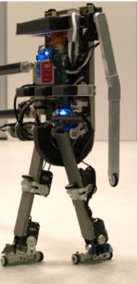
Memory-based Modeling and Prioritized Sweeping in Reinforcement Learning
August 27, 2010
Thijs Ramakers
MSc presentation
Supervisors:
Prof. Dr. R. Babuška
Dr. Ir. G. Lopes
Ir. E. Schuitema

Slide 2
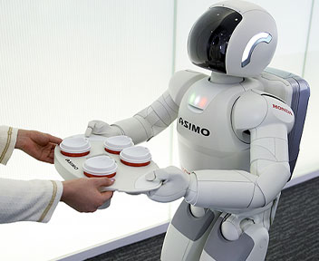
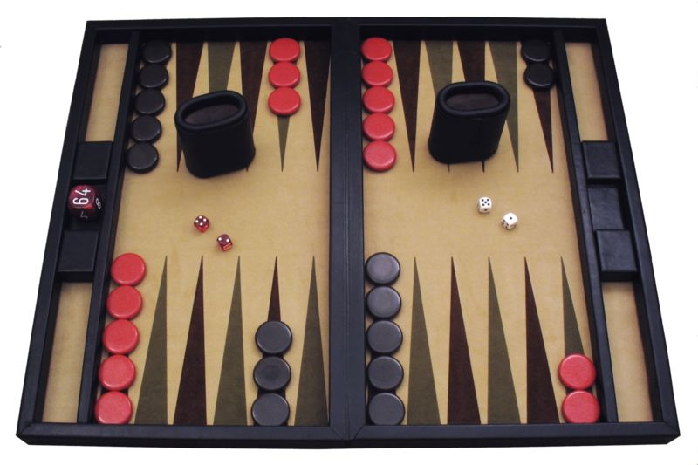
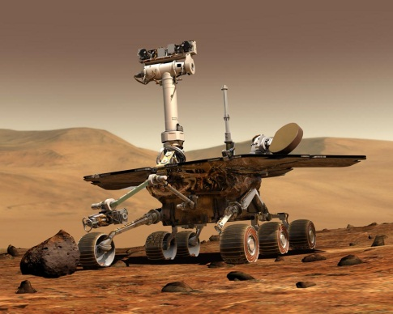
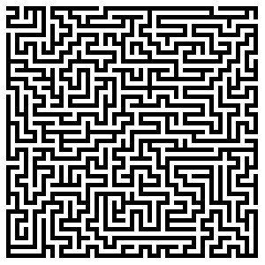
Reinforcement Learning
Optimization problems
Autonomous systems (robots)
Learn from mistakes
Adapt to unknown environment
Find non-trivial solutions

Slide 3
Reinforcement Learning method
Agent learns by trial-and-error
Repeat for every state s :
Try an action a
Observe a state-transition to s’
Receive reward r
Update (learn) value Q(s,a)
Maximize return:
Find value-function:
Control policy: choose action with highest return
Notes:
3
RL problems can be solved for relatively simple problems. For larger problems, learning becomes slow due to:
Continuous states. VF has to be approximated and a state is never encountered twice.
High number of dimensions: leads to a very high number of states. Makes it very difficult to determine VF for the total state-space
Slow propagation of information: Once the goal is found, this information propagates through the state-space very slowly.
This last problem is dealt with in the work.

Slide 4
Simple Reinforcement Learning example
Navigation of a 2 dimensional gridworld with obstacles
 |  |  |  |  |  | G
 |  |  | S
 |  |  |  |  |  | G
 |  |  | S
56 states
4 actions
Possible solution
Reward:
+1, Goal state
0, elsewhere
Notes:
RL problems can be solved for relatively simple problems. For larger problems, learning becomes slow due to:
Continuous states. VF has to be approximated and a state is never encountered twice.
High number of dimensions: leads to a very high number of states. Makes it very difficult to determine VF for the total state-space
Slow propagation of information: Once the goal is found, this information propagates through the state-space very slowly.
This last problem is dealt with in the work.

Slide 5
Solving a Reinforcement Learning problem
Solution: Find value function for the entire state-space
Method: By using a model or by interaction with real setup
Problem:
State-space is very large
Continuous state-variables
High-dimensional state-variables
Relatively few experiences to learn from
(one state-transition per sampling interval for real setups)
Notes:
RL problems can be solved for relatively simple problems. For larger problems, learning becomes slow due to:
Continuous states. VF has to be approximated and a state is never encountered twice.
High number of dimensions: leads to a very high number of states. Makes it very difficult to determine VF for the total state-space
Slow propagation of information: Once the goal is found, this information propagates through the state-space very slowly.
This last problem is dealt with in the work.

Slide 6

Model-learning approach
No a-priori model available, but interaction with setup only is not sufficient
Build a state-transition model:
Use model to simulate experiences
Use model and setup simultaneously
More experiences to learn from
$$MODEL(s_{t},a_{t})→s_{t+1}$$
Learning
Learning
Model
Controller
Model
Controller
Policy
Policy
Setup
action
Setup
Dyna
Agent
reward
reward
state
Notes:
6
Several solution approaches exist. We will focus on the model-learning approach.
Model-learning:
No a priori model is available, but model is learned during the learning process.
Solution method: Switching between on-line (model-free) and off-line (model-based) learning.
The model is used to generate more experiences to learn from. The same update rule is used for the model and the setup. Fill total sample interval with model-based experiences.

Slide 7
Problem statement
How can we on-line build and use a model in order to
speed up a reinforcement learning process on complex systems?
Presentation outline:
Modeling: how to build the model
Learning: how to use the model

Slide 8
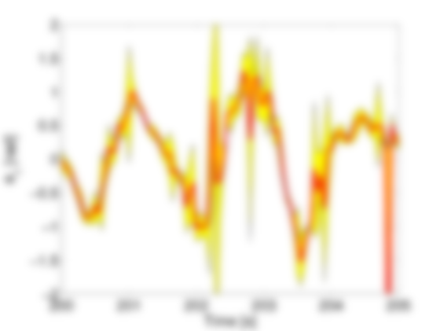
Modeling

Slide 9
Modeling requirements
Deal with continuous state variables
Model non-linear system
Applicable to high dimensional problems
Estimate model from few observations
Accurate enough to be used with learning
Notes:
9
Demands for the model-building technique:
Continuous states
Learning from few observations
Good accuracy (only in parts of state space?)
High dimensional problems
Efficient in CPU/memory usage (has to be applied in real time)

Slide 10
Memory-based modeling
Store all past experiences in memory
Estimate model when needed
Advantages:
+ Fast learning (new experiences are used immediately)
+ Adapt to changes
+ No fixed (global) structure needed
+ Statistical analysis possible
Disadvantages:
- Search large dataset for every estimation
- Noise sensitive
Notes:
10
Focus on a type of model-building technique called memory-based. A large number of experiences is simply stored in memory and used when needed.
Advantages:
Function can be approximated locally
No global structure is needed
Disadvantages:
Large dataset has to be stored.
Noise sensitive

Slide 11
Local Linear Regression (LLR)
Store observed experiences
(state, action → next state)
Search K nearest samples
(according to a distance measure)
Estimate linear model:
(using Least Squares techniques)
Results in a local linear model
y
ŷ
(K = 5)
X_{q}
x
Notes:
11
The K-Nearest Neighbor method also relies on storing past input-output pairs.
The estimated output is simply obtained by averaging the output of the K nearest stored inputs. Calculating the distances of all samples is the most computationally heavy.
K can be seen as a measure for the amount of generelization.
Local Linear Regression can be seen as an extension to KNN. Instead of averaging the outputs, a linear model is fitted to the K data samples. This leads to a piece-wise linear model.
A simple Least Squares approach can be used. Weighted Least Squares is also possible to give a higher weight to close samples.

Slide 12
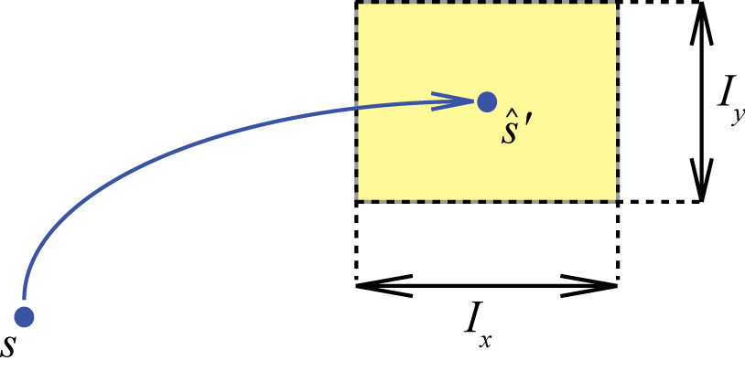
Model accuracy
Why?
Use only accurate estimates in learning algorithm
Detect faulty data (outliers/spikes/disturbances)
Improve model accuracy (tune K )
True (measured) output not available
95% confidence interval around estimate:
Prediction interval I :
(based on variance analysis of the residuals)

Slide 13
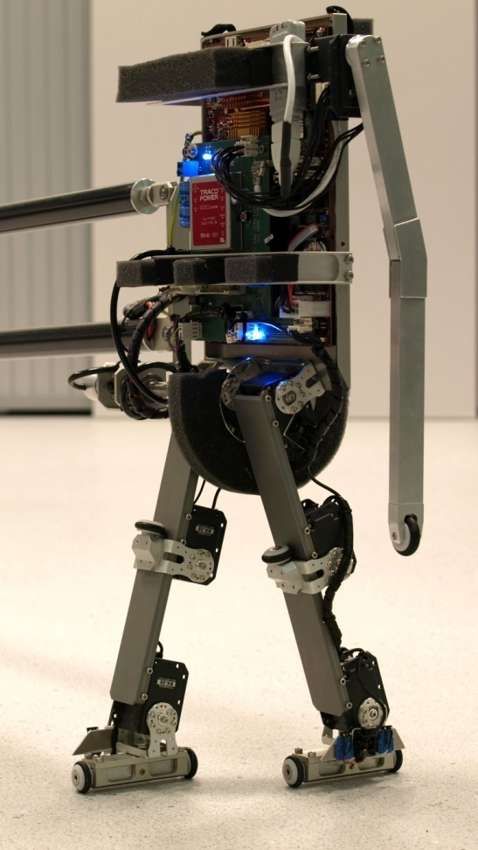
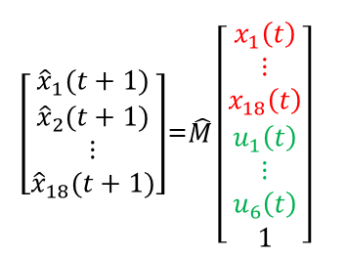
LLR Results: Humanoid robot setup
High-dimensional, complex robot
18 continuous state-variables
6 inputs
Dataset: pre-programmed walking motion
Estimate walking motion using LLR model
$\left[\begin{matrix}{\hat{x}}_{1}(t+1) \\ {\hat{x}}_{2}(t+1) \\ \begin{matrix}⋮ \\ {\hat{x}}_{18}(t+1)\end{matrix}\end{matrix}\right]$=$\hat{M}{\left[\begin{matrix}x_{1}\left(t\right) \\ ⋮ \\ x_{18}\left(t\right) \\ \begin{matrix}\begin{aligned}u_{1}\left(t\right) \\ ⋮ \\ u_{6}\left(t\right)\end{aligned} \\ 1\end{matrix}\end{matrix}\right]}^{}$
Humanoid robot ‘Leo’

Slide 14
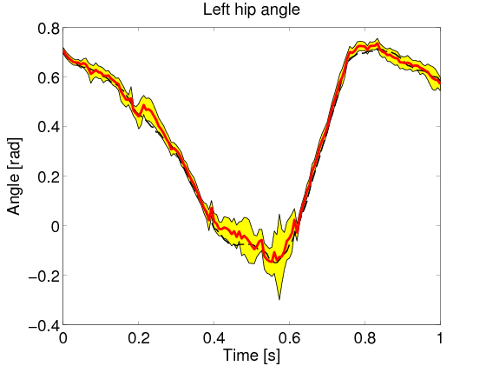
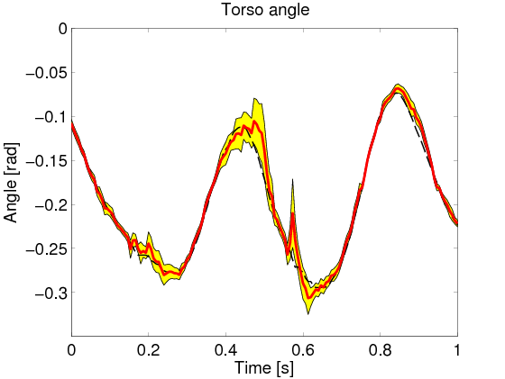
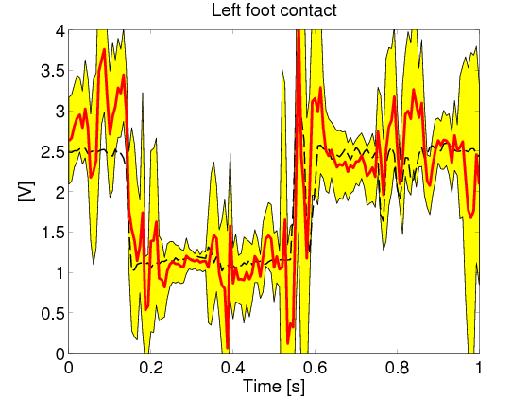
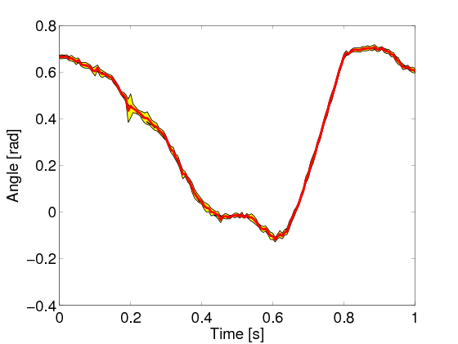
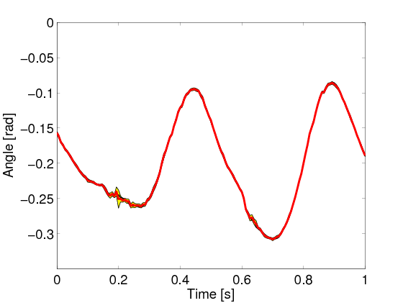
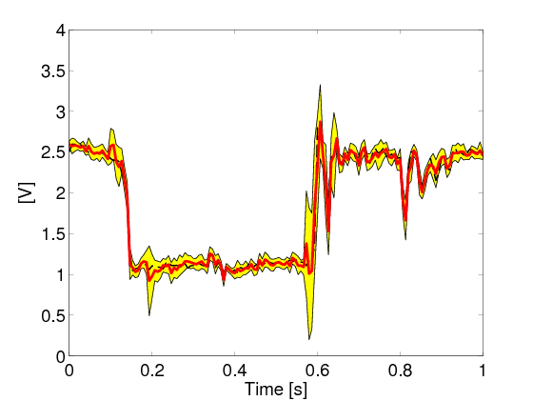
LLR Results: Humanoid robot model
Left hip
Torso
Left foot
Memory size:
150 samples
(2 footsteps)
Memory size:
6000 samples
(80 footsteps)
Measurement
LLR estimate
Prediction interval
LLR is able to model complex, high-dimensional system
Accurate model from relatively few samples (2 footsteps)

Slide 15
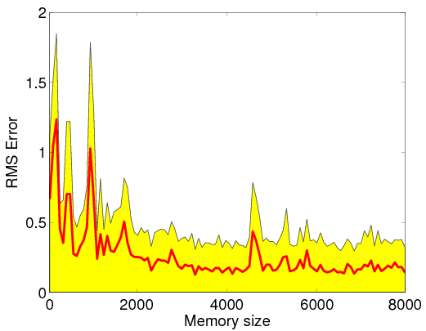
LLR Results: Prediction intervals
Estimation error decreases as memory size increases
Prediction intervals can be used as a measure of the estimation accuracy
Estimation error (RMS)
Prediction interval (RMS)

Slide 16
Modeling: Conclusions
Local Linear Regression is able to model high-dimensional, complex setups.
Accurate model using relatively few memory samples.
Prediction intervals can be used to assess the model accuracy based on memory samples only.

Slide 17
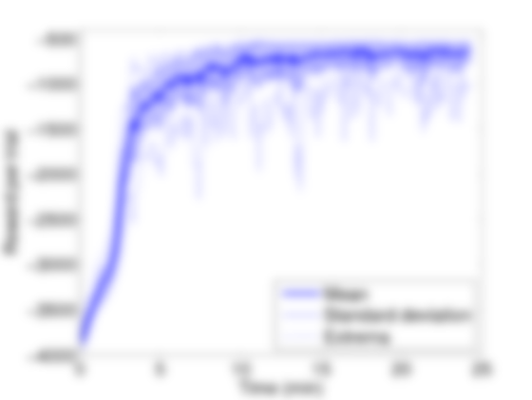
Learning

Slide 18
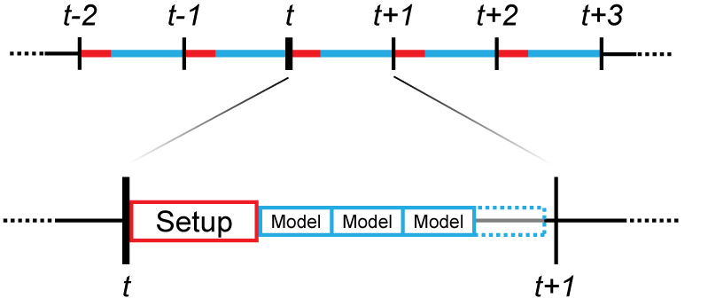
Dyna learning
Method to combine model with RL algorithms in an on-line setting
Dyna:
Learn from interaction with setup and model simultaneously
Use sampling interval more efficiently
Improve model during learning by adding samples to the memory

Slide 19
Comparison of different algorithms
SARSA (model-free)
Random Dyna
Prioritized Sweeping
Look Ahead Dyna
Notes:
19
Demands for the model-building technique:
Continuous states
Learning from few observations
Good accuracy (only in parts of state space?)
High dimensional problems
Efficient in CPU/memory usage (has to be applied in real time)

Slide 20
SARSA (model-free)
Learning
Learning
Controller
Controller
Policy
Policy
Setup
action
Setup
Dyna
Agent
reward
reward
Learn from interaction with setup only
Observe state-transition
Receive reward
Explore all the states and actions
Use real experiences only to
update value-function
Value function update:
state
 |  |  |  |  |  | G
 |  |  | S
2D gridworld example
Notes:
20
Demands for the model-building technique:
Continuous states
Learning from few observations
Good accuracy (only in parts of state space?)
High dimensional problems
Efficient in CPU/memory usage (has to be applied in real time)

Slide 21

Random Dyna (model-learning)
Learn from interaction with
setup and model simultaneously
Generate extra (modeled) experiences every time-step using LLR model:
Model-based experience is generated randomly
Learn from real and modeled state-transitions
 |  |  |  |  |  | G
 |  |  | S
$$s\left(t+1\right)=\hat{M}{\left[\begin{matrix}s(t) \\ \begin{matrix}a(t) \\ 1\end{matrix}\end{matrix}\right]}^{}$$
2D gridworld example
Notes:
21
Demands for the model-building technique:
Continuous states
Learning from few observations
Good accuracy (only in parts of state space?)
High dimensional problems
Efficient in CPU/memory usage (has to be applied in real time)

Slide 22
Prioritized Sweeping (model-learning)
Improve model-based learning:
Update useful states first
Store state-action pairs in a priority queue
Model-based experience is generated
according to priority
New for large, continuous
state-spaces and real setups
 |  |  |  |  |  | G
 |  |  | S
2D gridworld example
Notes:
22
Demands for the model-building technique:
Continuous states
Learning from few observations
Good accuracy (only in parts of state space?)
High dimensional problems
Efficient in CPU/memory usage (has to be applied in real time)

Slide 23
Look Ahead Dyna (model-learning)
Improve model-based learning:
Look ahead from current state
Model-based experience is generated to
predict future states.
Use model to estimate behavior close to current state
Proposed algorithm in this research
 |  |  |  |  |  | G
 |  |  | S
2D gridworld example
Notes:
23
Demands for the model-building technique:
Continuous states
Learning from few observations
Good accuracy (only in parts of state space?)
High dimensional problems
Efficient in CPU/memory usage (has to be applied in real time)

Slide 24
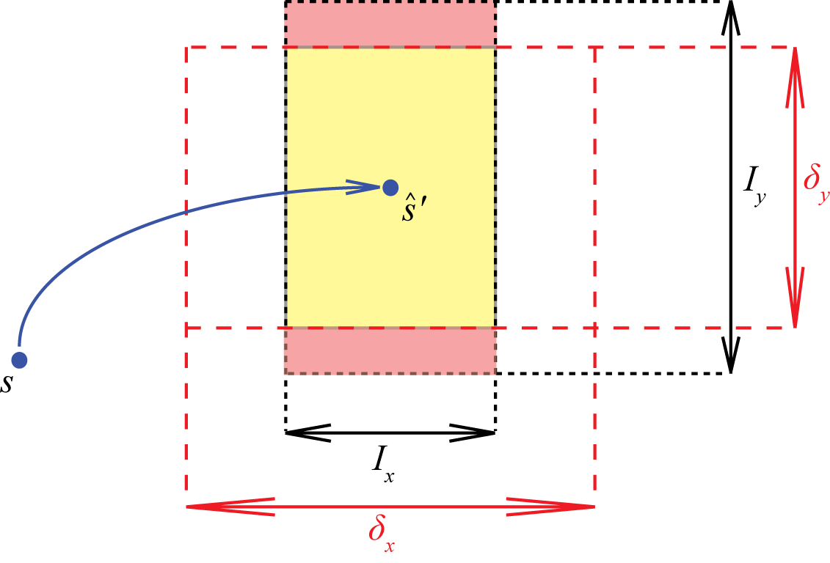
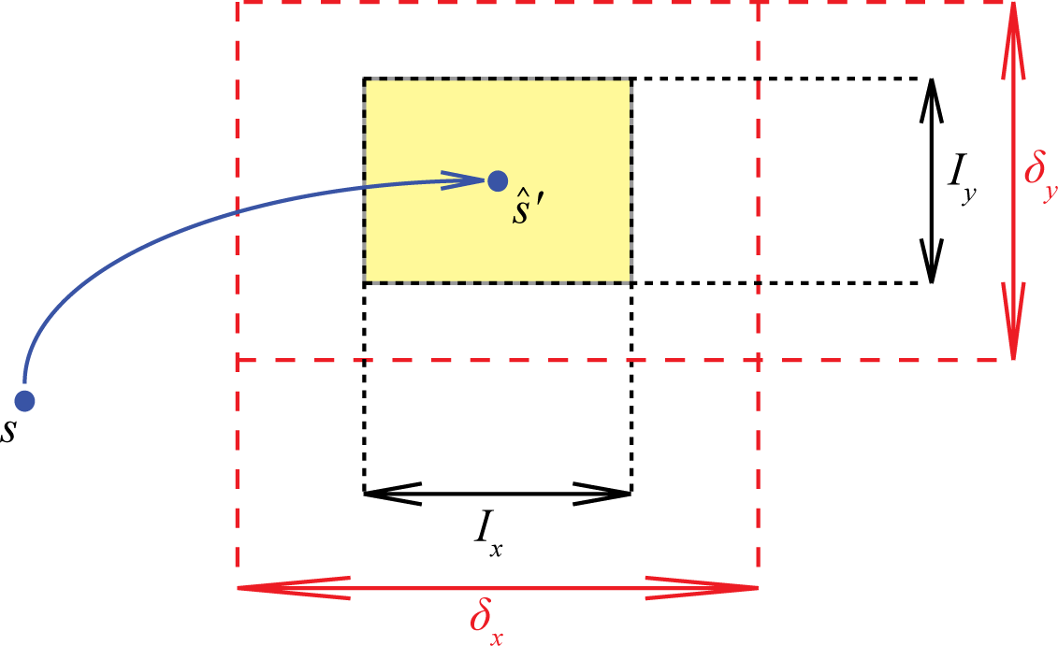


Prediction intervals
$$\left[I_{x}, I_{y}\right]$$
Calculate prediction interval
Introduce prediction interval limit
$$\left[δ_{x}, δ_{y}\right]$$
Use modeled state-transition
Discard modeled state-transition

Slide 25
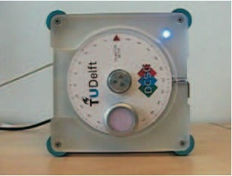
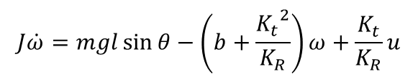
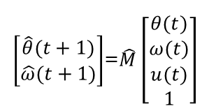


Learning setup: inverted pendulum simulation
2 continuous state-variables:
1 input: {-3V, 0, +3V }
Swing-up task
Reward:
Learning experiment:
1000 trials
100 time-steps per trial (3 seconds)
3 model-based experiences per time-step
θ, ω
$$r\left(θ,ω,u\right)=−\left[\begin{matrix}θ & ω\end{matrix}\right]Q\left[\begin{matrix}θ \\ ω\end{matrix}\right]−uRu$$
$$Q=\left[\begin{matrix}5 & 0 \\ 0 & 0.1\end{matrix}\right], R=0.01$$
m
Exact model:
LLR model:

Slide 26
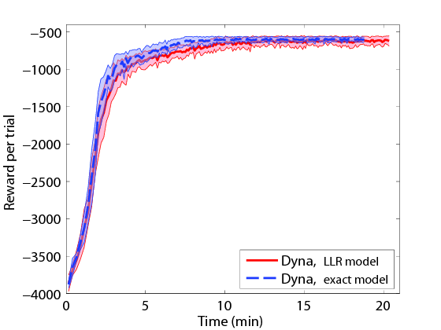
Learning results: Using LLR model
Final solution is slightly worse than for the exact model
Model-based experience is accurate enough to be used in learning

Slide 27
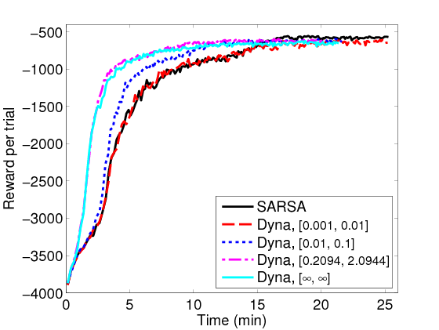
Learning results: SARSA and Random Dyna
Adding LLR model to learning process increases learning speed
Larger prediction interval limit → more experiences to learn from → faster learning

Slide 28
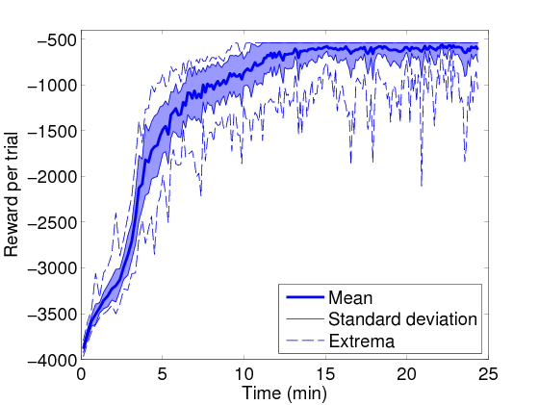
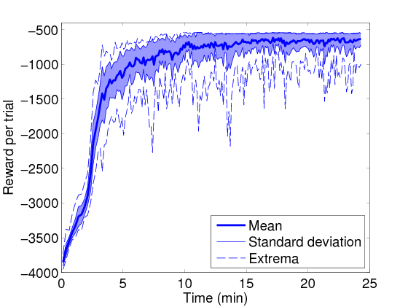
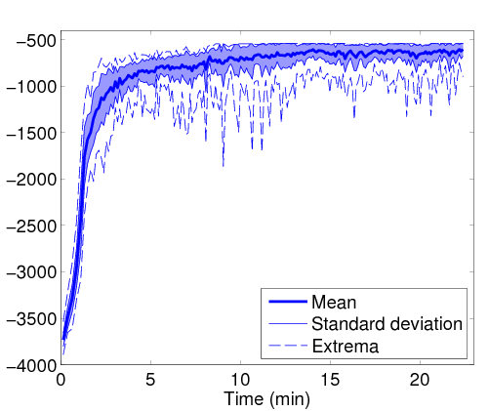
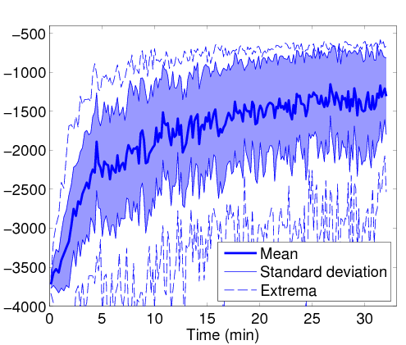
Learning results: Prioritized Sweeping
Prediction interval limit is needed to prevent ‘unlearning’
Optimal setting discards 7% of the modeled experiences
Increasing prediction interval limit
Mean
Standard deviation
Extrema

Slide 29
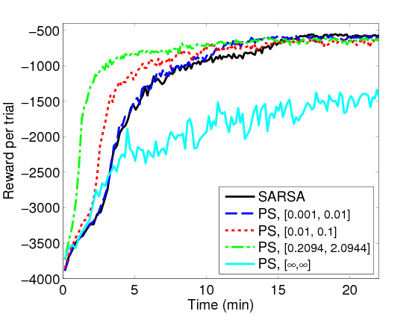
Learning results: Prioritized Sweeping (PS)
Prediction interval limit has a big effect on the learning speed
A trade-off between few very accurate and many inaccurate modeled state-transitions

Slide 30
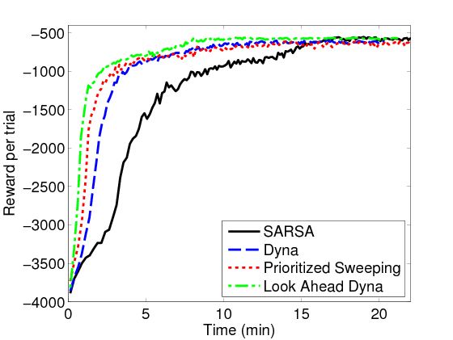
Learning results: Algorithms compared
Optimal settings for all algorithms
Dyna improves learning speed compared to model-free SARSA
Prioritized Sweeping and Look Ahead Dyna improve learning speed compared to random Dyna

Slide 31
Learning: conclusions
Adding model-based experiences to learning process can increase learning speed.
Learning speed can be further increased by generating model-based experience cleverly.
Prediction interval limits are needed for Prioritized Sweeping and Look Ahead Dyna to avoid ‘unlearning’.

Slide 32
Overall conclusions
Learning speed on real systems can be increased by adding model-based experiences to every sampling interval.
A model can be built duing the learning process using the observed state-transitions.
Choosing model-based experience cleverly is a way to increase learning speed compared to randomly chosen state-transitions.

Slide 33
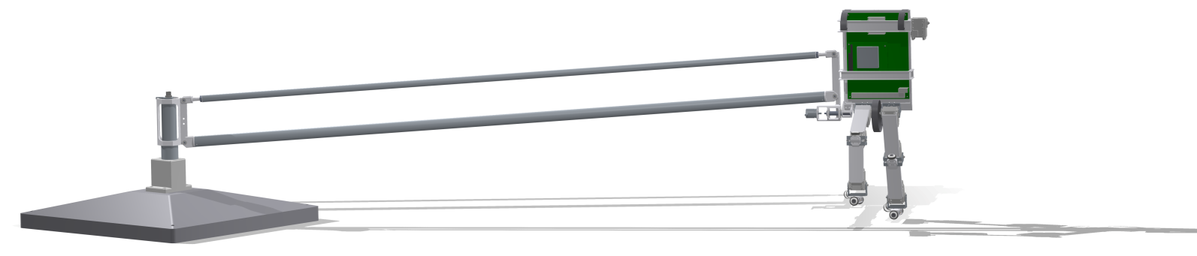
Questions?

Slide 34
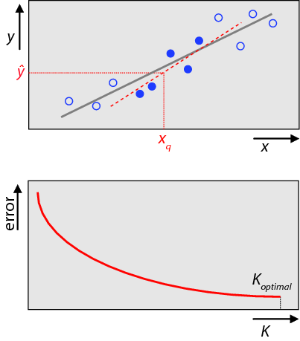
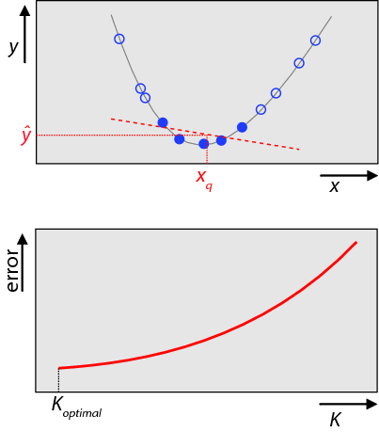
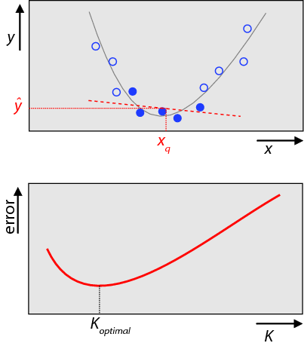
Local Linear Regression Optimal number of neighbors
Linear function with noise
Nonlinear function without noise
Nonlinear function with noise

Slide 35
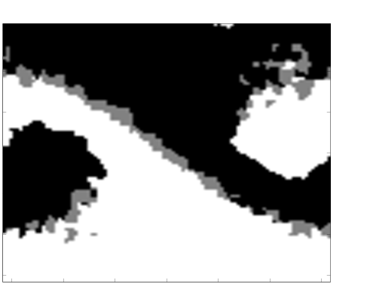
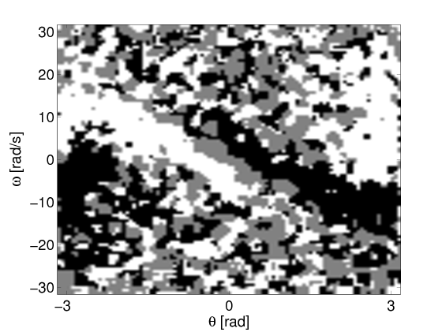
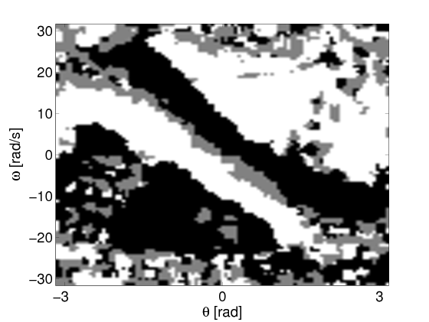
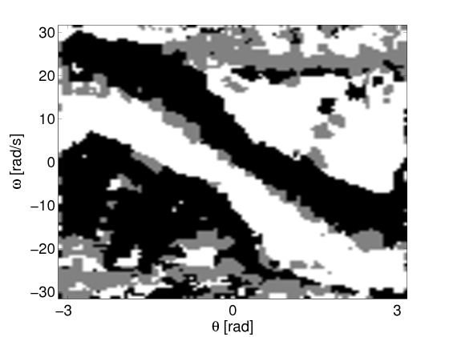
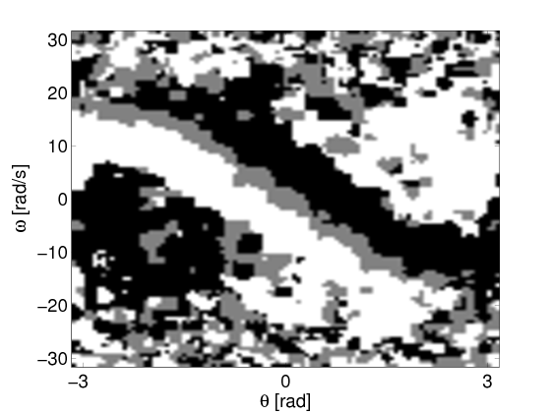
Final policies
Optimal policy
(converged)
SARSA
Prioritized Sweeping
Dyna
Look Ahead Dyna

Slide 36
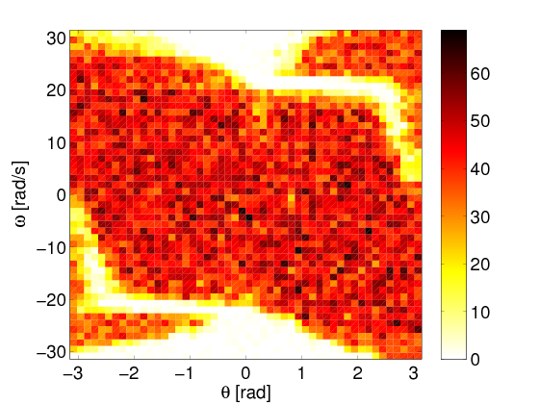
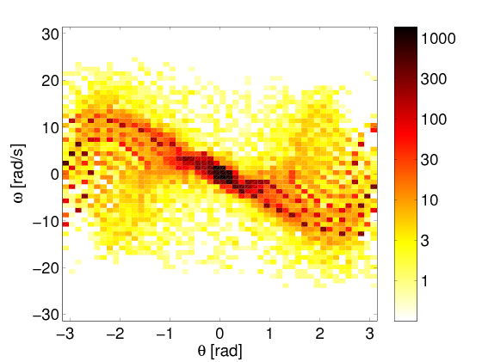
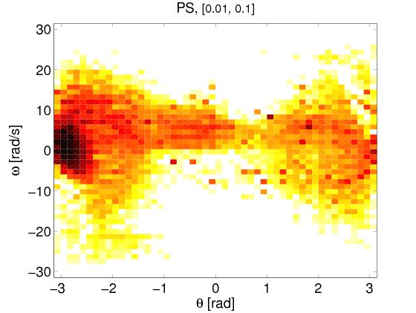
Sample distribution in different learning algorithms
States for which a state-transition was generated and used for learning
Dyna
Prioritized Sweeping
Look Ahead Dyna

Slide 37
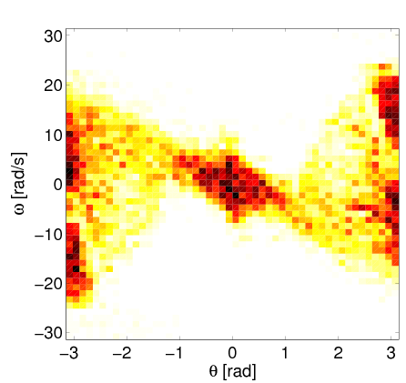
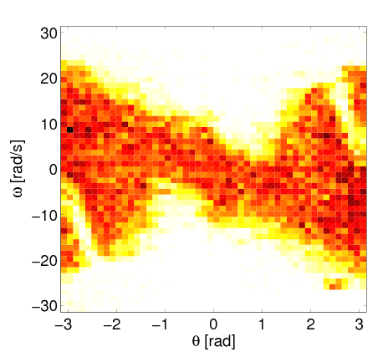
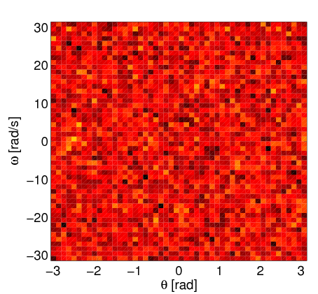
Sample distribution in random Dyna
States for which a state-transition was generated and used for learning
Increasing prediction interval limit
Increasing prediction interval limit
Increasing prediction interval limit

Slide 38
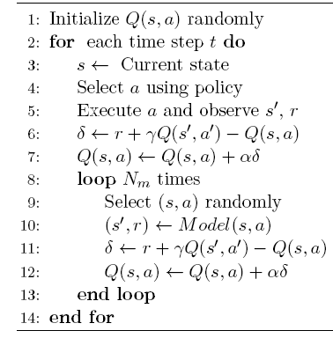
Dyna algorithm

Slide 39
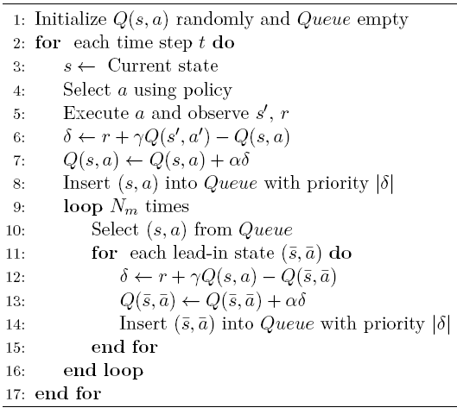
Prioritized Sweeping algorithm

Slide 40
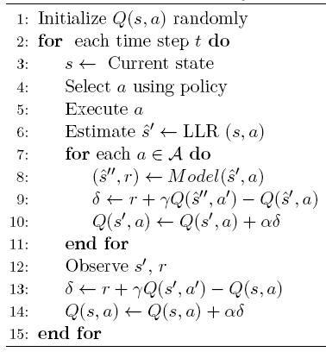
Look Ahead Dyna algorithm

Slide 41


Lead-in states
$$s\left(t\right)=\tilde{M}{\left[\begin{matrix}s(t+1) \\ \begin{matrix}a(t) \\ 1\end{matrix}\end{matrix}\right]}^{}$$
Build alternative model
Determine lead-in state for every action

Slide 42

Learning results (summary)

Slide 43

Learning results: Look Ahead Dyna
Prediction interval limit has a big effect on the learning speed
A trade-off between few very accurate and many inaccurate modeled state-transitions

Slide 44




Learning results: Look Ahead Dyna
Prediction interval limit is needed to prevent ‘unlearning’
Optimal setting discards 4% of the modeled experiences
Increasing prediction interval limit
Mean
Standard deviation
Extrema

